Slide 1
Data Journalism

Slide 2
What is Data Journalism?
Telling stories with data – data as a source

Slide 3
State of journalism
Association of Independent Publishers (AIP) study in 2012:
Mpumalanga:
While 71% of stories were potentially investigative, only 18% were investigative.
Limpopo:
While 73% of stories from papers were potentially investigative, only a quarter (24%) were actually investigative
Look at the event not the issue

Slide 4
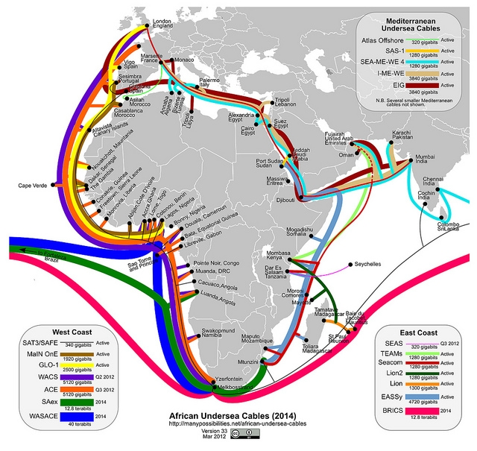
Information in Africa

Slide 5
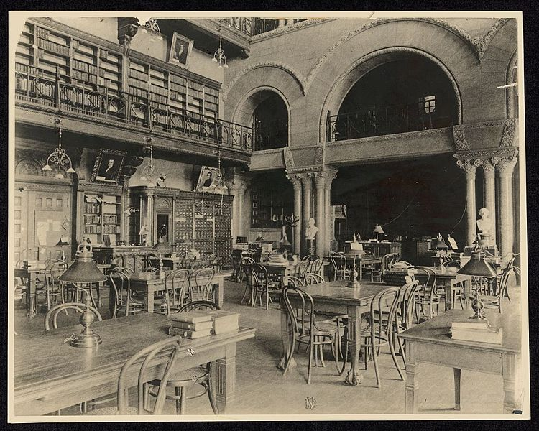
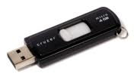
Open Data
Journalists are now data analysts
Reflect on the rapidly increasing amounts of data, as well as proximity of huge volumes of information at your fingertips that could have stories in them
1912 2012

Slide 6
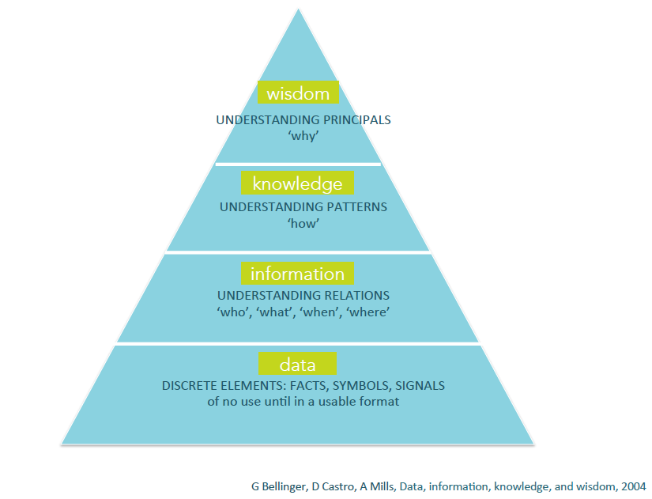

Slide 7

Data is machine-readable
Open data is free for anyone to reuse or redistribute for any person
Notes:
Working through the key definitions.

Slide 8
Data is often Ugly
Role of Data Journalists
Beautification & Storytelling
Ugly data → beautiful information and knowledge

Slide 9
Data Journalism
“Data journalism is obtaining, reporting on, curating and publishing data in the public interest.” (Jonathan Stray, professional journalist and a computer scientist)
“Data driven journalism is a workflow that consists of the following elements: digging deep into data by scraping, cleansing and structuring it, filtering by mining for specific information, visualizing it and making a story.”
(Mirko Lorenz, information architect and multimedia journalist)
Notes:
Prefer Jonathans simpler definition. In many senses just about learning a new language.

Slide 10
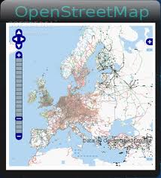
Examples of sources of open data
a) Open Government Data
UK, Kenya, USA
World Bank
Open Government Partnership
b) Community generated data
Open Street Map
Flickr, SlideShare

Slide 11






Breaking news has already broken…we need ‘issue’ reporting

Slide 12
When we are overloaded with information, we need journalists to make the connections between different forms of data that become really valuable and create a story.
Its not about events, but rather contexts and trends.

Slide 13
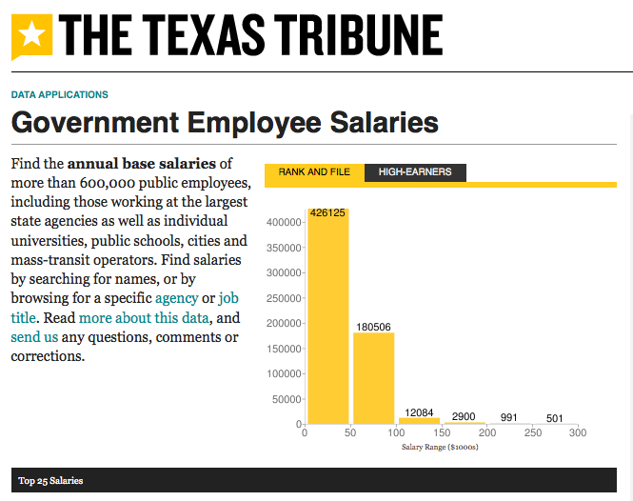
People want data journalism
The Texas Tribune gets most of its traffic from its interactive data pages – they have a dedicated data journalist.
http://bit.ly/IjKusr

Slide 14
“Data-driven journalism is the future. Journalists need to be data-savvy. It used to be that you would get stories by chatting to people in bars, and it still might be that you’ll do it that way some times. But now it’s also going to be about poring over data and equipping yourself with the tools to analyze it and picking out what’s interesting. And keeping it in perspective, helping people out by really seeing where it all fits together, and what’s going on in the country”.
— Tim Berners-Lee, founder of the World Wide Web

Slide 15
“I think it’s important to stress the “journalism” or reporting aspect of ‘data journalism’. The exercise should not be about just analyzing data or visualizing data for the sake of it, but to use it as a tool to get closer to the truth of what is going on in the world. I see the ability to be able to analyze and interpret data as an essential part of today’s journalists' toolkit, rather than a separate discipline. Ultimately, it is all about good reporting, and telling stories in the most appropriate way.”
— Cynthia O’Murchu, Financial Times

Slide 16

The “Murder Mysteries” project by Tom Hargrove of the Scripps Howard News Service.

Slide 17
From the Open Data Journalism Handbook.
He built from government data and public records requests a demographically-detailed database of more than 185,000 unsolved murders, and then designed an algorithm to search it for patterns suggesting the possible presence of serial killers. This project has it all: hard work gathering a database better than the government’s own, clever analysis using social science techniques, and interactive presentation of the data online. Could also show startling variances in solve rates – some areas a murder is more likely to remain unsolved than solved. Points directly to technique and approaches of particular police stations.
See further http://bit.ly/yT9wdh.

Slide 18

And…the Expenses Scandal again!
http://www.guardian.co.uk/news/datablog/interactive/2012/sep/07/full-list-mps-expenses-ipsa-data-interactive - Go Play!
Using ATI to get information, using data journalism to process. This leaked release of expense statements from MPs by the Telegraph in May 2009 (Rayner, 2009) brought widespread attention to a perceived lack of transparency by Government on how they spent the money paid to them in taxes. This ‘scandal’ led to changes throughout the political spectrum with much of the resulting data
now available (with regular updates) on data.gov.uk.

Slide 19
What is a data story?
Census, election results, service delivery, budget reporting, crime stats
However, narrative is not excluded:
What
History, dimensions, ...
Who
Individuals, crowds, ...
When
Dates, times, intervals, ...
Where
Locations; country, town, property, ...
Why
How

Slide 20
Step-by-step
How to create a data story

Slide 21
Data In
Analysis
Information out
Journalism then becomes about giving data meaning.

Slide 22
Data
Gathering information for a story
Connecting information that is gathered
Expressing information as a story
Localising and personalising news
Localizing a story is of increasing economic importance – as the data deluge continues, personalized content is King.

Slide 23

Work backwards from your idea!
What statements do you want to make?
What variables are needed to make those statements?
Who would collect data with those variables?
How will you get the data from the collector?

Slide 24

1. Statements?
Lede = hypothesis
Bullet points = statements
Examples for a crime and courts data story:
“Crime has increased/decreased X % since...”
“The X per 100.000 violent crime rate of Y City is the worst ...”
“Only X % of reported crimes result in arrests...”
Notes:
“An average of X drivers are arrested every day for DWI...”
“Robberies peak between X and Y o’clock on Z day...”
“One out of every X vehicles registered in Y City gets stolen ...”
“The average sentence from Judge X for robbery is Y years...”

Slide 25
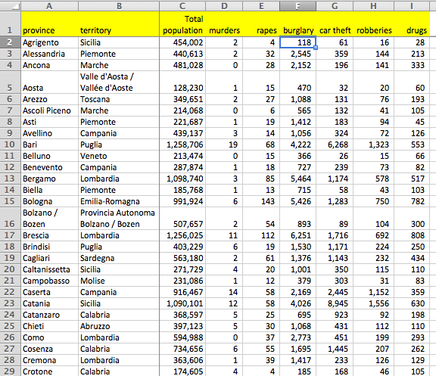
2. Variables needed?
Columns = variables
Rows = records
Two main kinds of variables
Categorical: Sex, city, postal code, type of crime, etc...
Numeric: Age, cost, population, weight, arrests, accident, etc...
Notes:
variables for crime and courts story: Type of crime, population, date, time, location, number of victims, arrest made?, disposition, judge, sentence...

Slide 26

3. Who collects those variables?

Slide 27



4. Get the data!

Slide 28
1. Finding the Data
Using PAIA
Browse data sites and services:
http://databank.worldbank.org/ddp/home.do
http://www.africaopendata.org/ (soon to be openAFRICA)
http://interactive.statssa.gov.za/superweb/login.do (STATSSA)
Scraping
ScraperWiki
Ask a Forum or a Mailing List or an expert
Get The Data
Quora.
NICAR-L
Join HacksHackers
http://www.meetup.com/HacksHackersAfrica/
Notes:
For more information, see the Open Data Handbook. The forum examples are mainly American.
Promotion of Access to Information Act

Slide 29
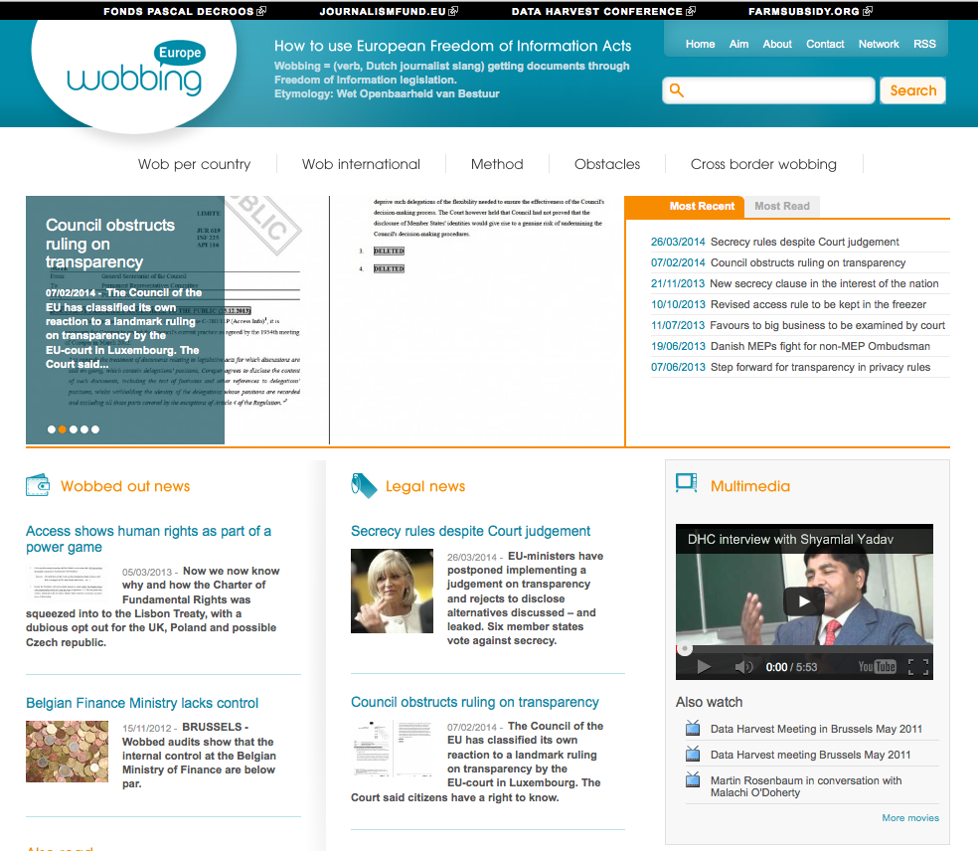


Public records tools
Notes:
Wobbing – public records requests

Slide 30
Streamlining Your Search
Here are a few tips:
Include both search terms relating to the content of the data, as well as some information on the format or source (file type).
For example, you can look only for spreadsheets by appending your search with filetype (filetype:XLS filetype:CSV’), geodata (‘filetype:shp’), or database extracts (‘filetype:MDB, filetype:SQL, filetype:DB’).
You can also search by part of a URL. Googling for ‘inurl:downloads filetype:xls’ will try to find all Excel files that have “downloads” in their web address. You can also limit your search to only those results on a single domain name, by searching for, e.g. ‘site:agency.gov’.
“quotes search for exact phrase”
+ ensures it contains a word: +logs
Ensures words are omitted: -wooden
~ synonyms: ~death

Slide 31
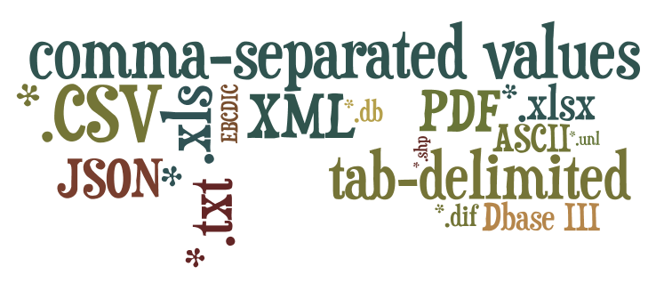
Data formats?

Slide 32


Avoid PDFs
Notes:
Programs like Excel can save to PDF

Slide 33
Avoid PDFs...but if necessary...
Convert to *.xls with:
Acrobat Pro
Zamzar
CometDocs
(many others)

Slide 34

...Now what??
You have data...

Slide 35

Clean the data
2.Connecting and interrogating the data
Notes:
Standardize!
Collected for bureaucratic reasons

Slide 36




Data cleaning tools
Notes:
Open Refine
TextWrangler

Slide 37

Look for patterns
Notes:
Frequencies
Averages, medians, range
OUTLIERS!

Slide 38




Excel tools
Learn to love excel
Sort
Filter
Functions
Pivot tables

Slide 39
The main contribution of excel for your data:
Sorting
Organises into more revealing order.
Filtering
Gets rid of unnecessary data
Using math and text functions
AutoSum, median, maximum, minimum
Pivot tables
Helps to sort large data sets and re-organise by different labels or ‘variables’
Notes:
See your packs for instructions. http://datadrivenjournalism.net/resources/video_precision_journalism_workshop_at_the_school_of_data_journalism

Slide 40
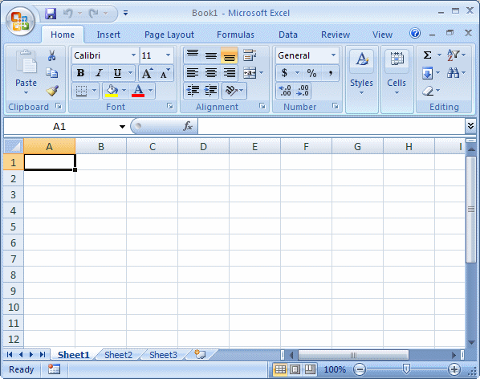
Excel terms
Columns
Formulas:
=
Row
Worksheets

Slide 41
DocumentCloud Tool
DocumentCloud for analysis of documents
Sorts through OpenCalais, you can annotate and reference your story from the source doc, then share

Slide 42
3. Visualizing and Expressing the Data
Always remember, its essentially just charts.
Interactive – UK riots
Google Public Data (Google charts)
The Joy of Data (more visualisation gospel)
World Bank data, maps
UN data
Stats SA
Also about applications for delivering stories.

Slide 43
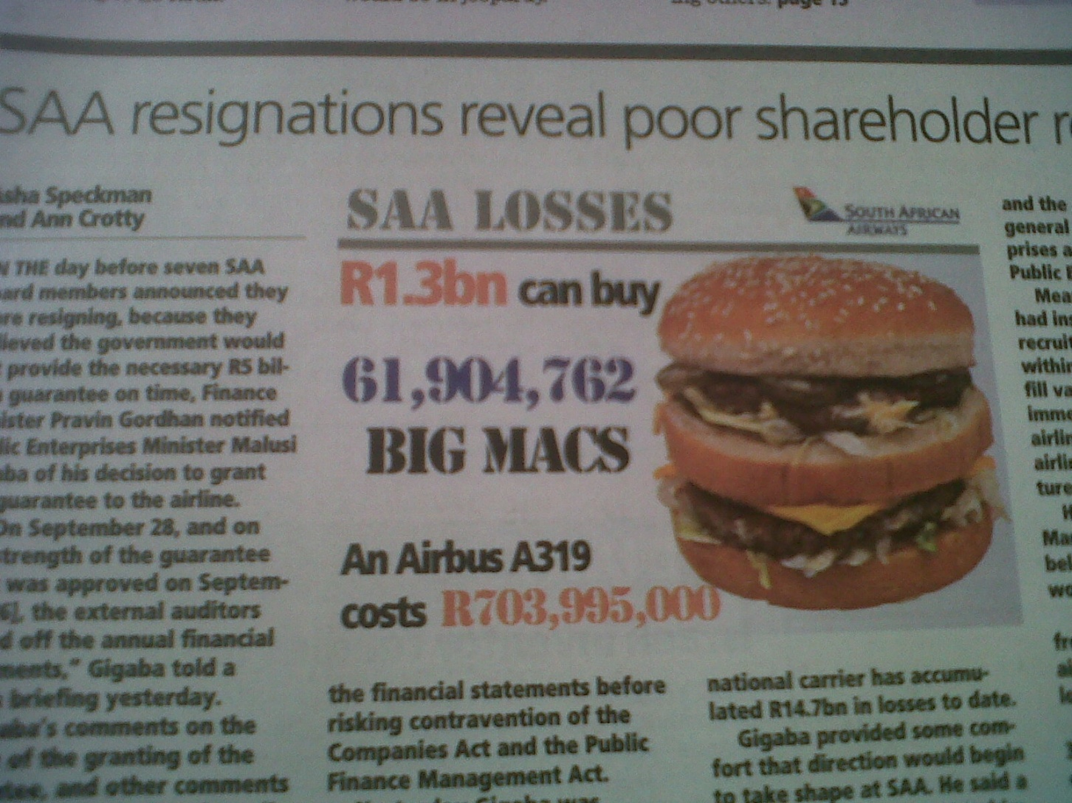
What not to do…
Where’s the story?
Notes:
Cape Times, 16 October 2012.

Slide 44
Tool | Category | Multi-purpose | Mapping | Platform | Skill | Data stored | Designed for
 |  | visualization |  |  | level | or processed | Web publishing?
Data Wrangler | Data cleaning | No | No | Browser | 2 | External server | No
Google Refine | Data cleaning | No | No | Browser | 2 | Local | No
R Project | Statistical analysis | Yes | With plugin | Linux, Mac OS X, Unix, Windows XP or later | 4 | Local | No
Google Fusion Tables | Visualization app/service | Yes | Yes | Browser | 1 | External server | Yes
Impure | Visualization app/service | Yes | No | Browser | 3 | Varies | Yes
Many Eyes | Visualization app/service | Yes | Limited | Browser | 1 | Public external server | Yes
Tableau Public | Visualization app/service | Yes | Yes | Windows | 3 | Public external server | Yes
VIDI | Visualization app/service | Yes | Yes | Browser | 1 | External server | Yes
Zoho Reports | Visualization app/service | Yes | No | Browser | 2 | External server | Yes
Choosel | Framework | Yes | Yes | Chrome, Firefox, Safari | 4 | Local or external server | Not yet
Exhibit | Library | Yes | Yes | Code editor and browser | 4 | Local or external server | Yes
Google Chart Tools | Library and Visualization app/service | Yes | Yes | Code editor and browser | 2 | Local or external server | Yes
JavaScript InfoVis Toolkit | Library | Yes | No | Code editor and browser | 4 | Local or external server | Yes
Notes:
Online Visualisation Tools.

Slide 45
Tool | Category | Multi-purpose | Mapping | Platform | Skill | Data stored
 |  | visualization
 |  |  |  |  | level | or processed
OpenHeatMap | GIS/mapping: Web | No | Yes | Browser | 1 | External server
OpenLayers | GIS/mapping: Web, Library | No | Yes | Code editor and browser | 4 | local or external server
OpenStreetMap | GIS/mapping: Web | No | Yes | Browser or desktops running Java | 3 | Local or external server
TimeFlow | Temporal data analysis | No | No | Desktops running Java | 1 | Local
IBM Word-Cloud Generator | Word clouds | No | No | Desktops running Java | 2 | Local
Gephi | Network analysis | No | No | Desktops running Java | 4 | Local
NodeXL | Network analysis | No | No | Excel 2007 and 2010 on Windows | 4 | Local
CSVKit | CSV file analysis | No | No | Linux, Mac OS X or Linux with Python installed | 3 | Local
DataTables | Create sortable, searchable tables | No | No | Code editor and browser | 3 | Local or external server
FreeDive | Create sortable, searchable tables | No | No | Browser | 2 | External server
Highcharts* | Library | Yes | No | Code editor and browser | 3 | Local or external server
Mr. Data Converter | Data reformatting | No | No | Browser | 1 | Local or external server
Panda Project | Create searchable tables | No | No | Browser with Amazon EC2 or Ubuntu Linux | 2 | Local or external server
PowerPivot | Analysis and charting | Yes | No | Excel 2010 on Windows | 3 | Local
Weave | Visualization app/service | Yes | Yes | Flash-enabled browsers; Linux server on backend | 4 | Local or external server

Slide 46
4. Personalisation
Your users are an additional source of data:
“Give me a headline to a story that I have no interest in and I'm not likely to click it; suggest a topic that I know something about and I'll read the article”. Sarah Marshall
Personalised content is King
Solution to “info glut” – filters out noise
About developing personal connections between publication and reader
Link to local content

Slide 47
Extra suggestions for starter tools
ICFJ Anwhere
Online lessons
Many Eyes
Visualisation
Google fusion tables
Mapping
Don’t forget Open Street Map
Google Refine
Tool for cleaning up data

Slide 48
Sharing data and collaboration
Publish your own data using an open license
Creative Commons
Work with existing communities
ODADI, HacksHackers
Use and support existing initiatives and technologies
ODADI, CKAN, Code4SA
Keep innovating
Newsrooms should develop toolboxes for:
Data gathering and capturing (eg spreadsheets in Google docs for team collaboration)
Analysis
Visualisation

Slide 49
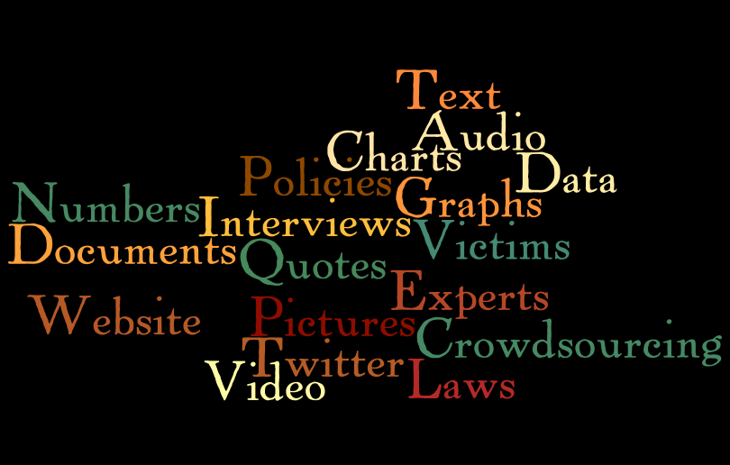
Data journalism story elements

Slide 50
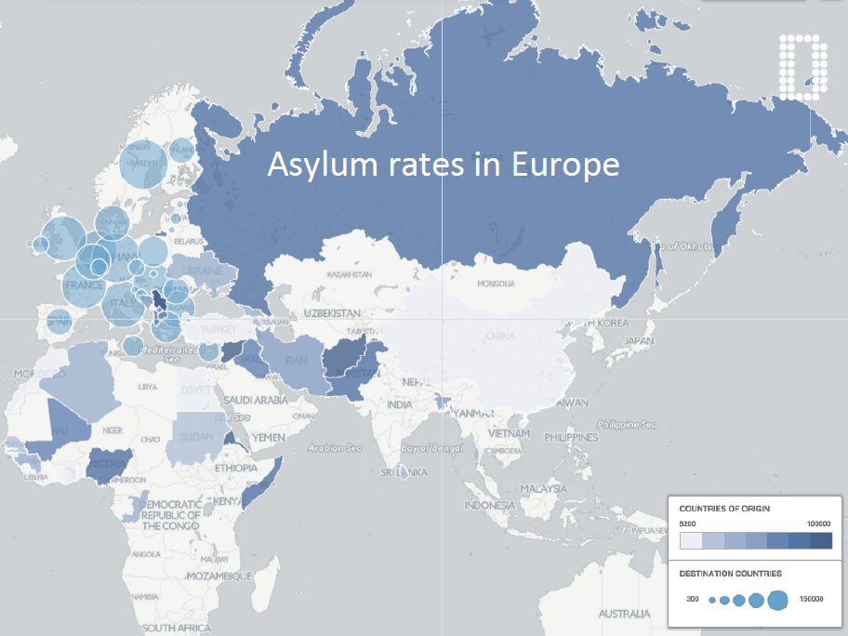

Slide 51
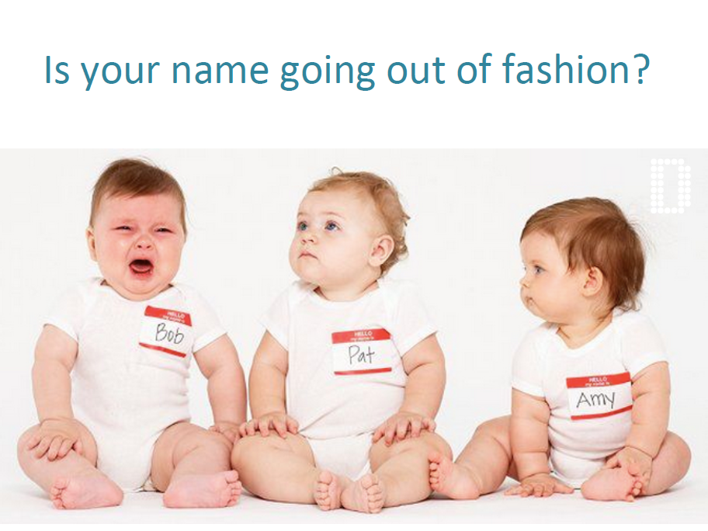

Slide 52
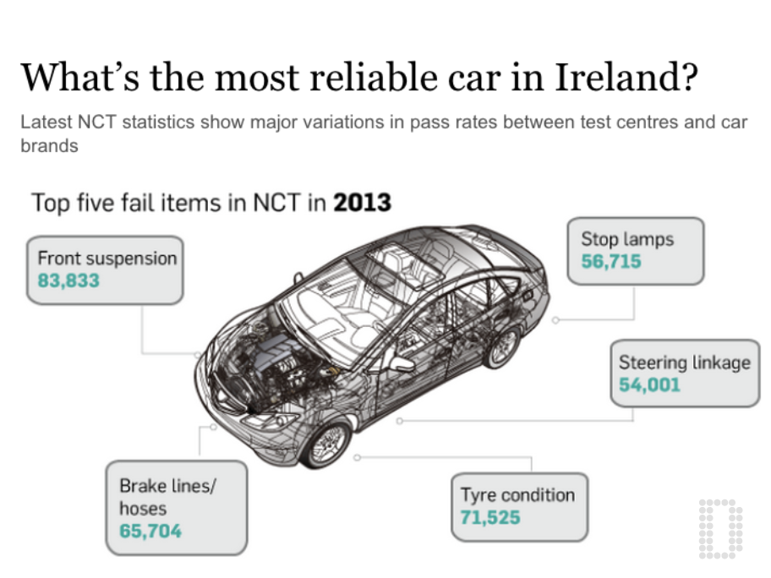

Slide 53
